Slide 1

Title
subtitle
Energy Workforce Equity Portal
Illinois Power Agency

Slide 2
Presentation Roadmap
Goals for the presentation
Overview of CEJA and collaboration between DCEO, IPA and workforce training programs
Definitions Overview
The Energy Workforce Equity Portal
Benefits of the Equity Portal
Next Steps
Q&A

Slide 3
Goals of Presentation
Demonstrate how Energy Workforce Equity Portal works to carry out goals outlined by CEJA
Provide overview of resources available through the Equity Portal
Clarify how CEJA and FEJA grantees can use the Equity Portal to support their work

Slide 4

CEJA: Purpose
The Climate and Equitable Jobs Act (CEJA, P.A. 102-0662) was signed into law by Governor Pritzker on September 15, 2021. CEJA is comprehensive energy legislation that:
  Incentivizes renewable energy development;
  Strengthens the diversity, equity, and labor standards applicable to the growing clean energy economy;
  Creates statewide clean energy workforce training programs to ensure our workforce is prepared for the jobs of the future; and
  Equitably supports communities facing energy transitions and much more.

Slide 5
CEJA: A Collaborative Effort
The Department of Commerce and Economic Opportunity (DCEO) is charged with administering the workforce and economic development programs outlined in the Climate and Equitable Jobs Act.
The Illinois Power Agency (IPA) is charged with implementing the Equity Accountability System which includes establishing an Energy Workforce Equity Portal to connect Equity Eligible Persons and clean energy companies, as well as ensuring the Minimum Equity Standard (MES) is met by companies participating in IPA programs and procurements.
CEJA and FEJA Grantees are instrumental in prioritizing Illinoisans who have historically faced economic barriers and environmental damage, with the goal of bolstering a diverse workforce in the clean energy industry.

Slide 6
Definitions Overview
Equity Eligible Person (EEP): The Illinois Power Agency Act (20 ILCS 3855/1-10) defines Equity Eligible Persons as “persons who would most benefit from equitable investments by the State designed to combat discrimination" and further specifies that four criteria will be used to determine EEP eligibility:
Persons who graduate from or are current or former participants in qualifying CEJA or FEJA grantee workforce training programs*
Persons who are graduates of or current enrolled in the foster care system
Persons who were formerly incarcerated
Persons whose primary residence is in an equity investment eligible community (EIEC)
*qualifying programs described in detail on next slide

Slide 7
Definitions Overview
Qualifying CEJA or FEJA grantee workforce training programs:
CEJA:
  Clean Jobs Workforce Network Program
  Clean Energy Contractor Incubator Program
  Illinois Climate Works Pre-apprenticeship Program
  Returning Residents Clean Jobs Training Program
  Clean Energy Primes Contractor Accelerator Program
FEJA:
  Solar training pipeline and multi-cultural jobs program (created in paragraphs (a)(1) and (a)(3) of Section 16-108.21 of the Public Utilities Act)

Slide 8

Definitions Overview
Equity Eligible Contractor (EEC): The IPA Act defines an Equity Eligible Contractor as “a business that is majority-owned by eligible persons, or a nonprofit or cooperative that is majority-governed by eligible persons or is a natural person that is an eligible person offering personal services as an independent contractor.”
Minimum Equity Standard (MES): The minimum percentage of EEPs within the total workforce of an entity seeking to participate in IPA's Illinois Shines program or a competitive procurement For the delivery year of 2025-2026, the MES is 14%.

Slide 9
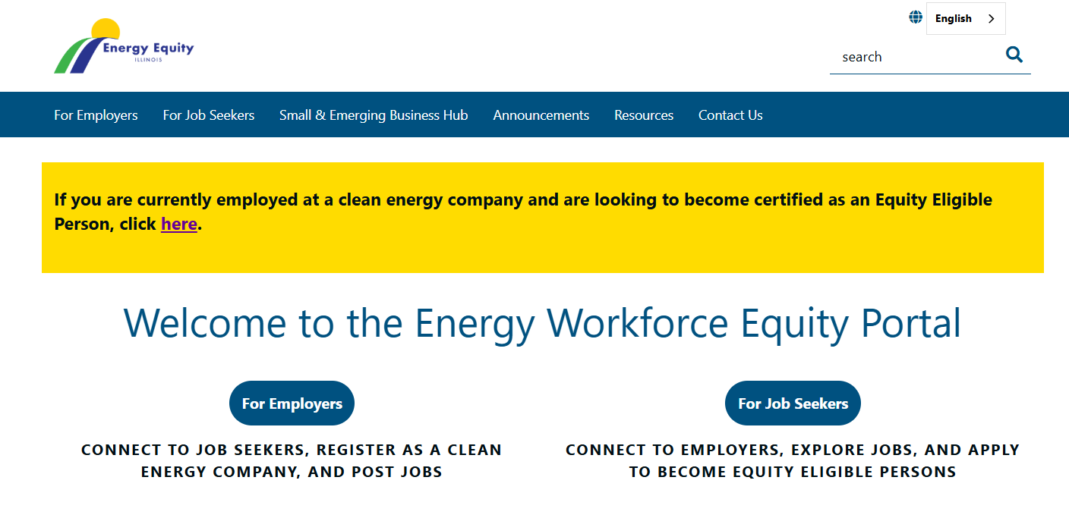
The Energy Workforce Equity Portal

Slide 10
The Energy Workforce Equity Portal
Goals:
Help individuals find out whether they qualify as Equity Eligible Persons and register.
Connect EEPs with prospective employers and find jobs.
Allow clean energy companies to register, post jobs, recruit EEPs and verify EEP status of current employees.
Help Equity Eligible Persons find information on workforce training programs and more.
Provide list of current EECs and qualified job training programs to help employers to meet the MES.
Providing resources for both job seekers and clean energy companies including training, funding opportunities, updates in the sector, information about CEJA, FEJA, MES, and how to get involved.
URL: https://energyequity.illinois.gov/

Slide 11
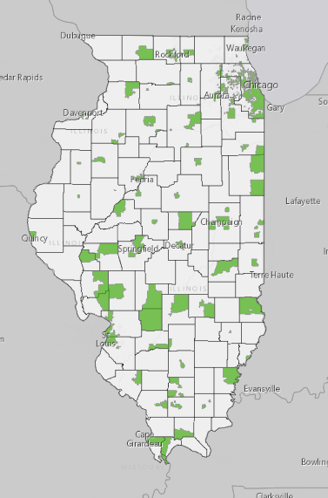
Resources for Job Seekers
Key Functions of the Portal for Job Seekers:
Equity Eligible Person (EEP) Registration: https://energyequity.illinois.gov/job-seekers.html
When an individual enrolls in your program, they will qualify as an EEP simply by being enrolled. Set aside time to help them register
EEP applicant can apply for themselves, or program staff can register on their behalf
Approved EEPs can choose to have information displayed for prospective employers
Resources
  Listings for clean energy companies and clean energy job postings
  Information regarding qualifying workforce training programs
  Equity Investment Eligible Community Map
  Equity Portal inbox: IPA.EnergyEquity@illinois.gov
  FAQs and user guides
Notes:
Demonstrate map useage

Slide 12
EEP Qualification: Documentation Needed
Qualifying CEJA or FEJA Training Program Certificate of completion Formal communication from program staff confirming enrollment | Equity Investment Eligible Community *must recertify every two years State ID or Driver's License Utility Bill Pay Stub Mortgage Agreement or Lease
Additional Information:
If registering on behalf of an EEP, an attestation form is required
Equity Eligible Person applicants requesting to qualify based on former incarceration or former/current foster care enrollment do not need to submit any documentation for approval.
For EEPs who qualify based on participation in a CEJA or FEJA training program, former incarceration and former/current foster care enrollment, no recertification post-approval is necessary

Slide 13
Resources for Employers
Key Functions of the Portal for Employers:
Register as a Clean Energy Company: https://app.smartsheet.com/b/form/4e3bf9f0a63e4cb8b77c05c27c3dcc10
After registration approval, clean energy companies will be able to submit job postings and view list of Equity Eligible Persons
Resources
  Information regarding the Minimum Equity Standard (MES)
  User guide to help navigate the Equity Portal
  List of FEJA and CEJA Workforce Training Programs – companies can use these contacts to help support recruitment efforts to meet MES
  Other Training Programs (non-EEP qualified) for building skills
  Grant and funding opportunities
  Equity Eligible Contractor (EEC) and Approved Vendor (AV) list to support companies in meeting MES
Notes:
From the perspective of job seekers, need to reframe for this perspective rather than benefits for employers. Show off the for employers page - if you are a subcontractor or a job seeker, pitch it from the example of their perspective

Slide 14


Resources for Small Businesses or Contractors
Small and Emerging Business Hub:
Learn About Illinois Solar Incentive Programs
  Read through the Small and Emerging Business guide to get a step-by-by step guide of becoming an AV or a Designees
Get Help Starting and Growing Your Business
  Consulting services, no cost support, and childcare or educational services
Discover Financial Support for your Business
  Grants and funding opportunities
Connect with Workforce and Training Programs
Notes:
Note that some EEPs are looking to start their own business or become a contractor, eventually

Slide 15
Resources for Job Training Programs
EEP registration and "on behalf of" feature to help participants apply and access job opportunities
  Can be built into job training program process
EEC and clean energy companies/jobs list to help job developers engage with companies and place their participants
Small & Emerging Business Hub to support small businesses and contractors get started and grow their businesses in the solar economy
Other Education and Training Programs to support program participants grow their skill set
Notes:
Highlight how the EEC list or clean energy jobs list can be used as tools to support job developers engage with companies and place their participants.

Slide 16
Next Steps for Job Training Programs
Make EEP registration part of your training program's process: Registering EEPs as a part of your training program ensures they'll have access to job postings and resources on the Equity Portal
Two Options:
Have program participants apply at the start or end of your program – they'll need either written communication (email) confirming their enrollment in the program, or a program certificate
Register for program participants on their behalf – you'll need an EEP Attestation form, which can be found in the online application form
Online form: https://app.smartsheet.com/b/form/a662d496abad4207b2778754aa19c7ff
Notes:
Highlight how the EEC list or clean energy jobs list can be used as tools to support job developers engage with companies and place their participants.

Slide 17



Q&A
Contact us
IPA.EnergyEquity@illinois.gov
https://energyequity.illinois.gov/

